Slide 1
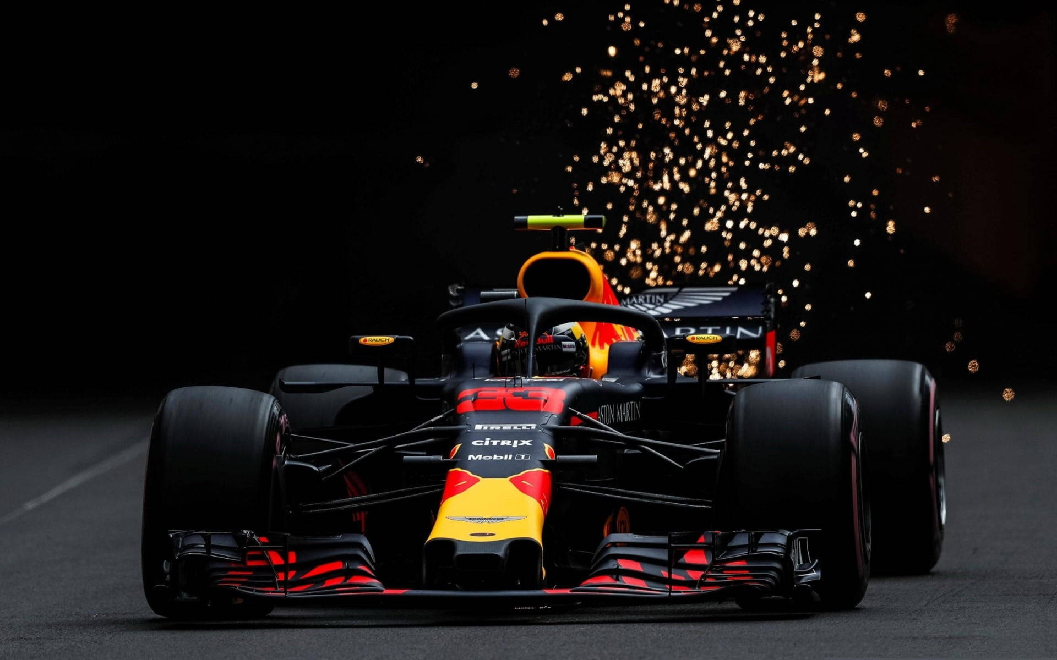
Finish Line Forecasters: F1 Data-Driven Foresights
A Comprehensive Model Incorporating Track, Location, and Historic Data
Anusha Udayakumar

Slide 2
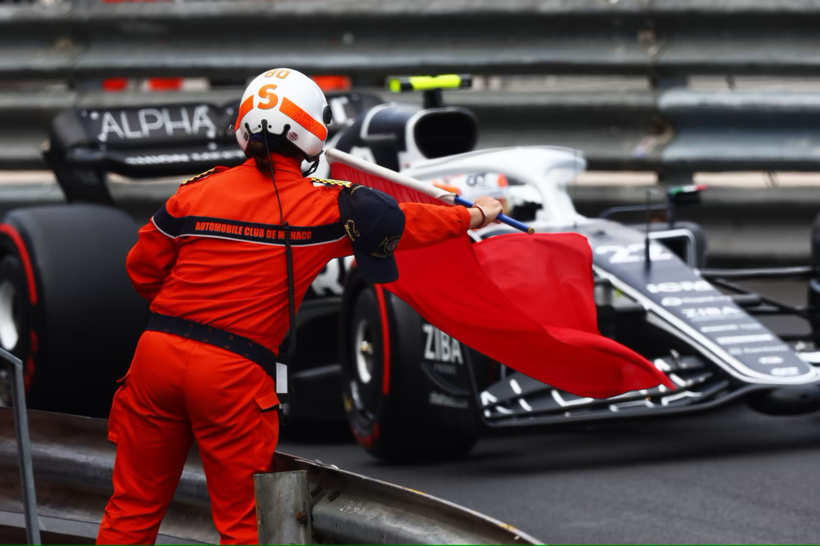
PROBLEM STATEMENT | GOAL | OBJECTIVE
How can historical data from previous F1 seasons be utilized to forecast the outcomes of the 2024 season? Which variables beyond historical data, driver/team performance, might significantly impact the outcomes of the season? How accurate can the predictions realistically be, considering the inherent unpredictability of races? | To create a predictive model that accounts for the dynamic nature of racing, providing accurate and reliable insights into potential outcomes, thereby enhancing our understanding of the complex interplay of factors influencing Formula 1 seasons | To develop a comprehensive framework that leverages historical data, driver/team performance metrics, track characteristics, weather conditions, and other pertinent variables to forecast the outcomes and standings of the 2020 Formula 1 season
PROBLEM STATEMENT
GOAL
OBJECTIVE

Slide 3
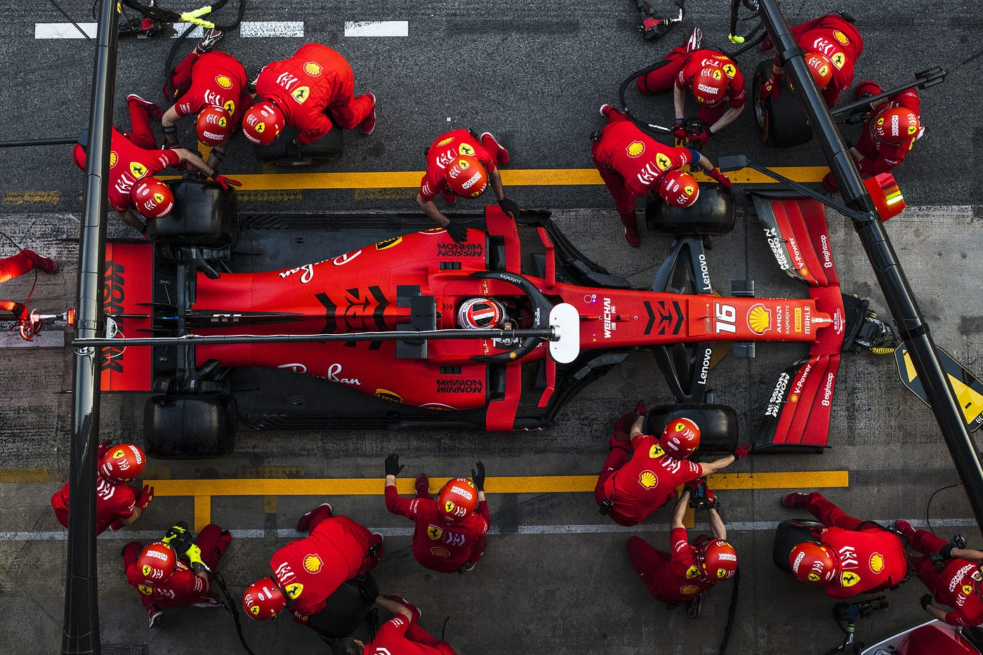
DATASET OVERVIEW
Data Source :
Ergast API via FastF1 Python Package
Years Available : 1951-2023
Data Quality : Relatively clean data
Race Information
Circuits
Races
Seasons
Competition and Results
Constructor Standings and Results
Results
Participants:
Drivers
Constructors
Performance Metrics:
Lap Times
Pit stops

Slide 4
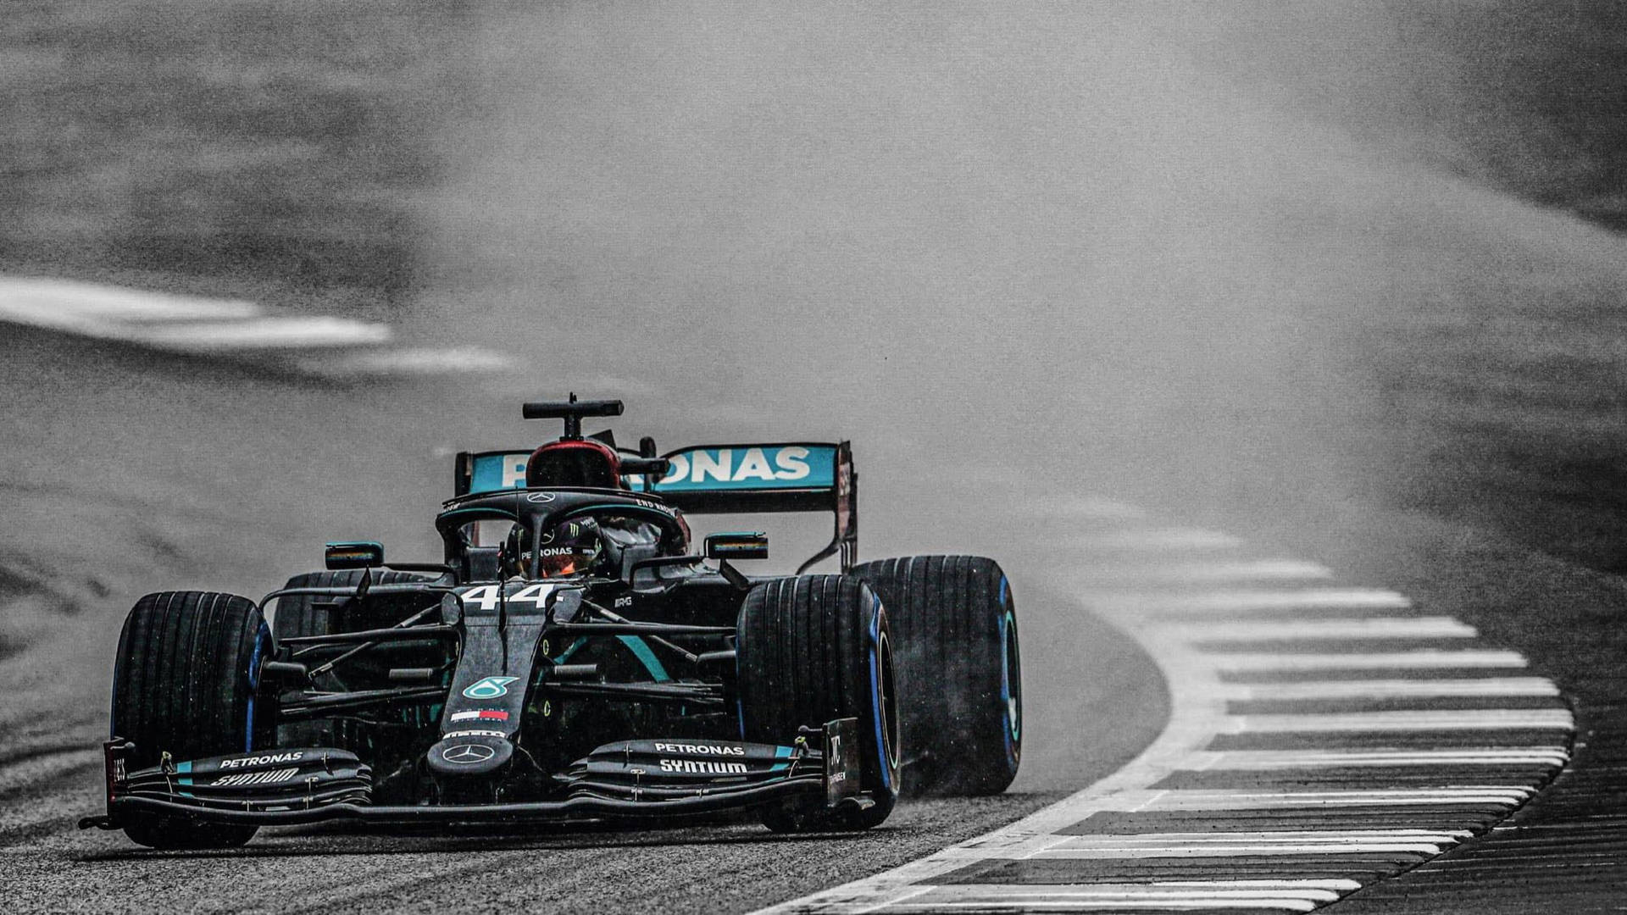
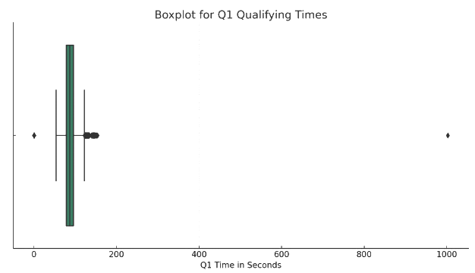
FEATURE ENGINEERING
Removed missing values indicated by '/N' values.
Also removed non-finish(dnf) or retired instances in milliseconds which didn’t add value to the dataset .
Focused analysis on a refined dataset spanning 2016-2023 to consider identical and independent distributions in recent times
Excluded outliers from lap time records to ensure data accuracy.
Merged metadata with the results dataset to incorporate comprehensive driver-related information.
Removed redundant pit stop data that was already present in the results dataset.

Slide 5
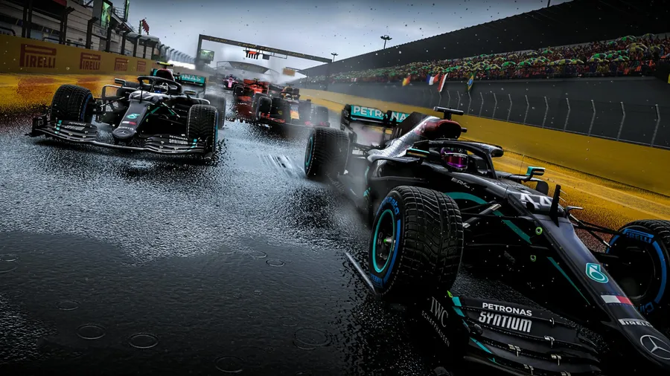
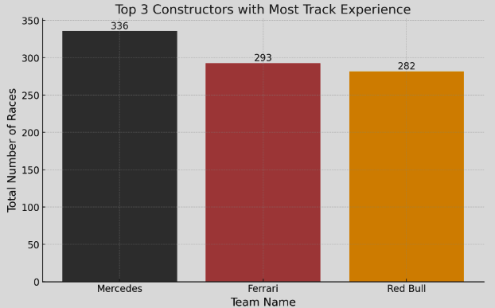
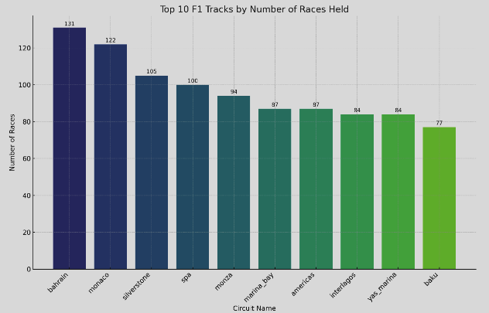
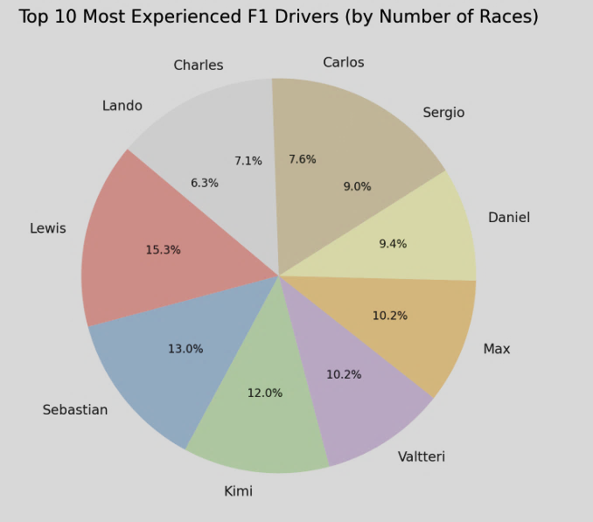
EDA – Track , Constructor and Driver

Slide 6
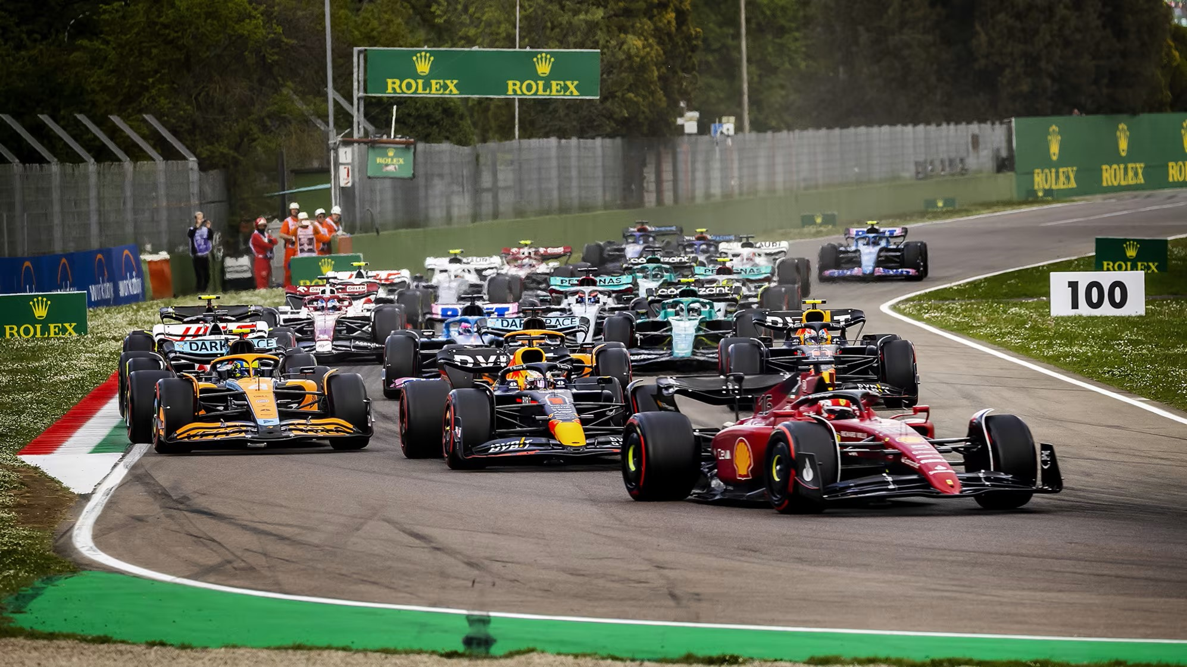
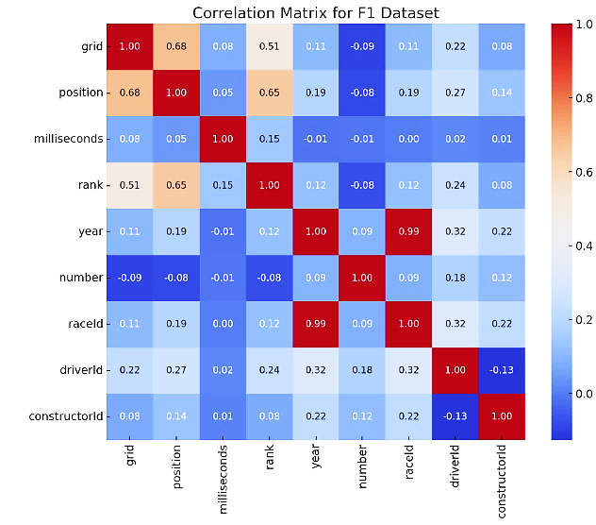
CORRELATION ANALYSIS
Grid Position and Final Race Position:
Expected correlation: Lower grid position relates to higher final position.
Negative value implies a closer front grid position relates to a higher final position.
Milliseconds and Rank:
Interesting correlation between total race time and rank.
Positive correlation suggests longer race times associate with lower ranks.

Slide 7
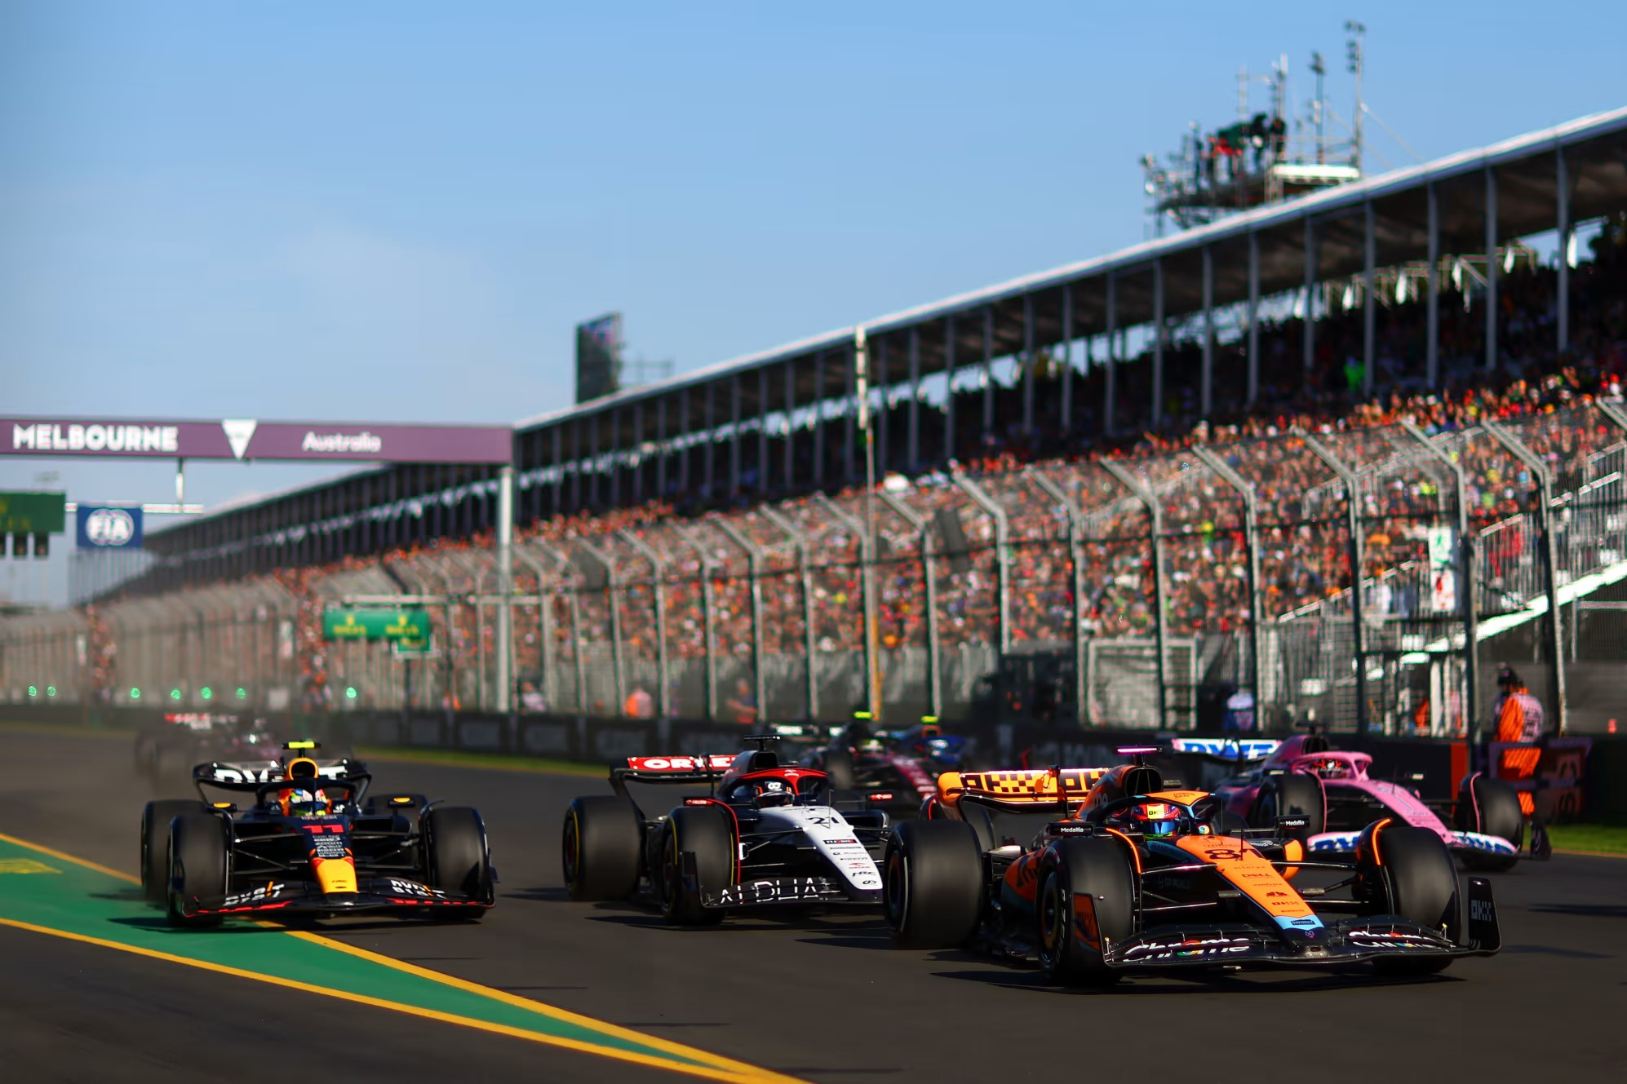
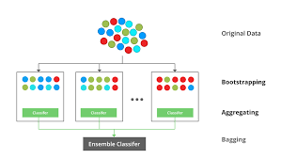
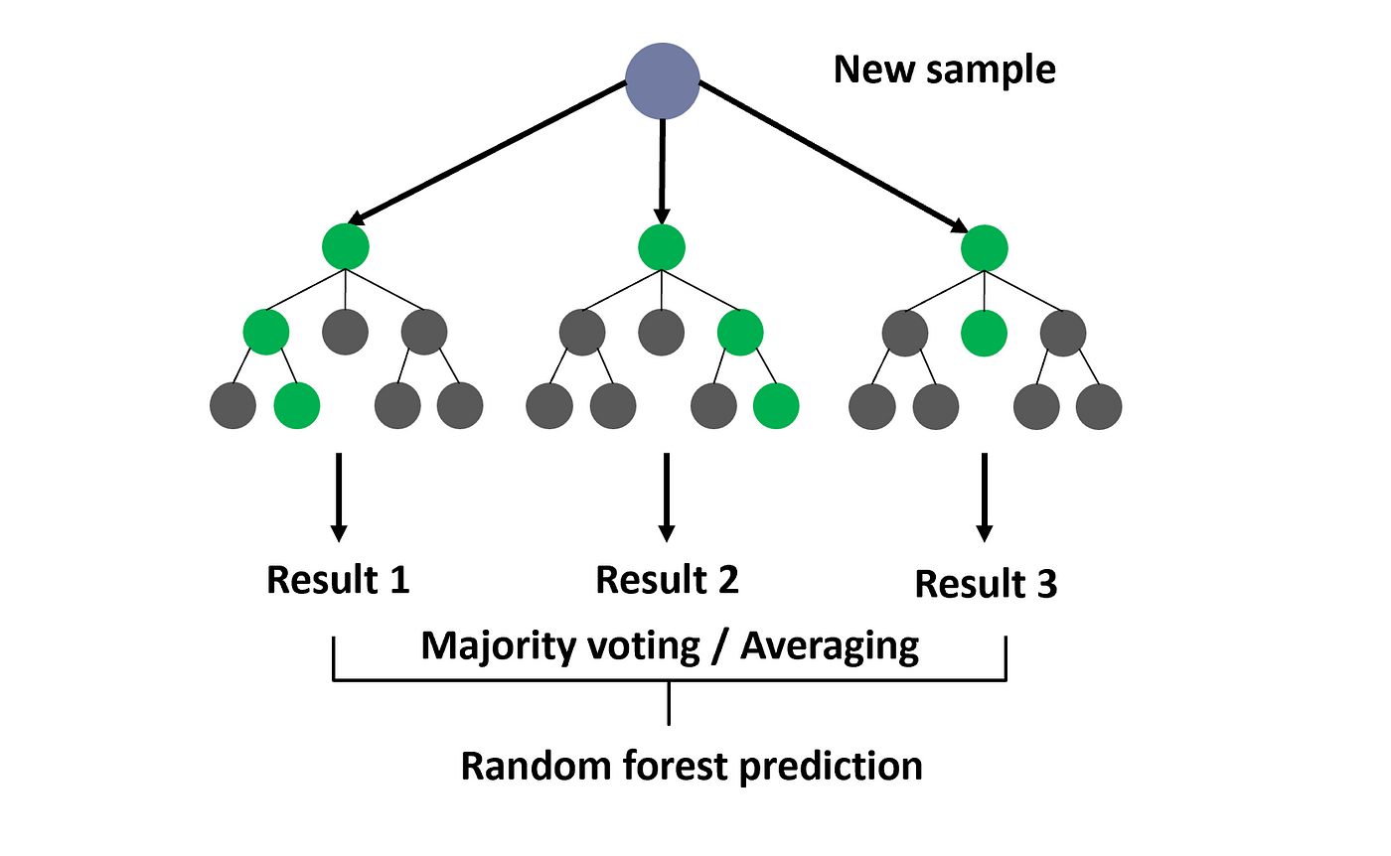
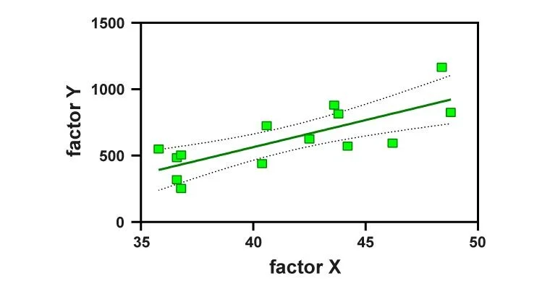
Model Development
Model Used XGBoost Random Forest Multi Linear Regression
Hyper Parameter Tuning
Cross Validation
Standard Cross Validation
Scaling
Standard Scaling

Slide 8
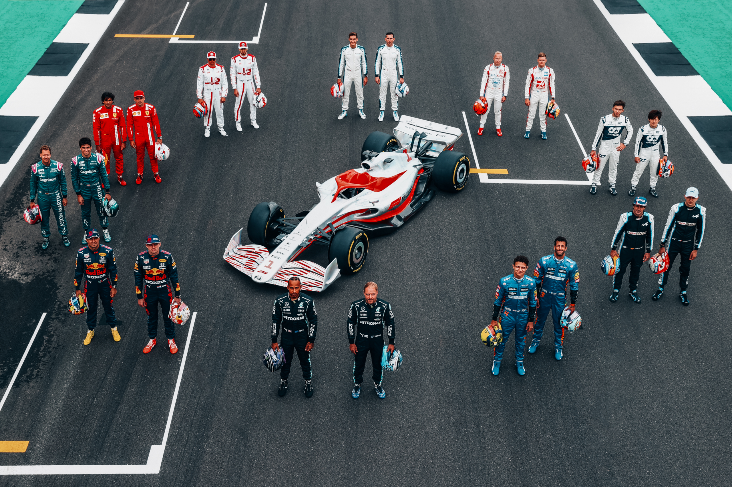
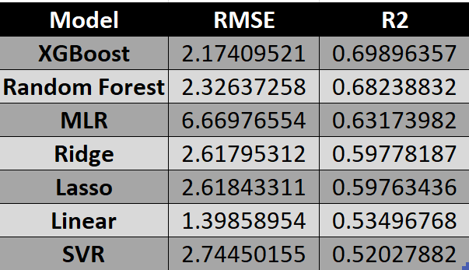
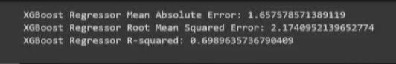
Model Performance​

Slide 9

FUTURE SCOPE
CHALLENGES
Weather Conditions: Assess how weather conditions (temperature, humidity, etc.) affect tire behavior and degradation. This data can be vital in predicting optimal tire choices for specific races.
Regulation Changes: Consider the impact of any rule changes or technical regulations for the upcoming season. These alterations can significantly affect team performance and race outcomes.
Technological Advancements: Assess the influence of new technologies, innovations, or advancements in car design, simulation tools, or even tire compounds that could alter race dynamics.
Confidential data of Engines and Tires
Tire Strategies and Performance.
Historical Tire Data: Analyze historical tire selection patterns for different teams and drivers across various circuits. Explore how different tire compounds have influenced race outcomes in the past.
Circuit-Specific Tire Analysis: Understand how tire degradation varies based on circuit characteristics. Some tracks might be more demanding on tires, affecting strategy and performance.

Slide 10

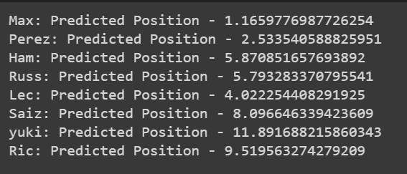
PREDICTION FOR 2024

Slide 11

Thank You !

